Slide 1

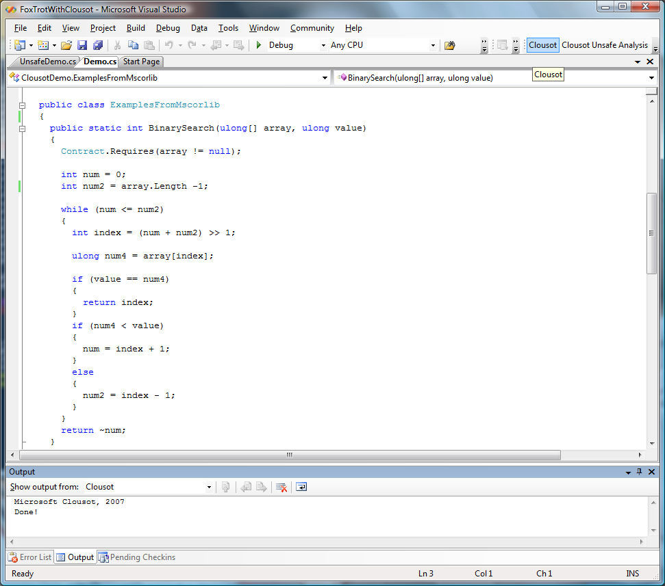
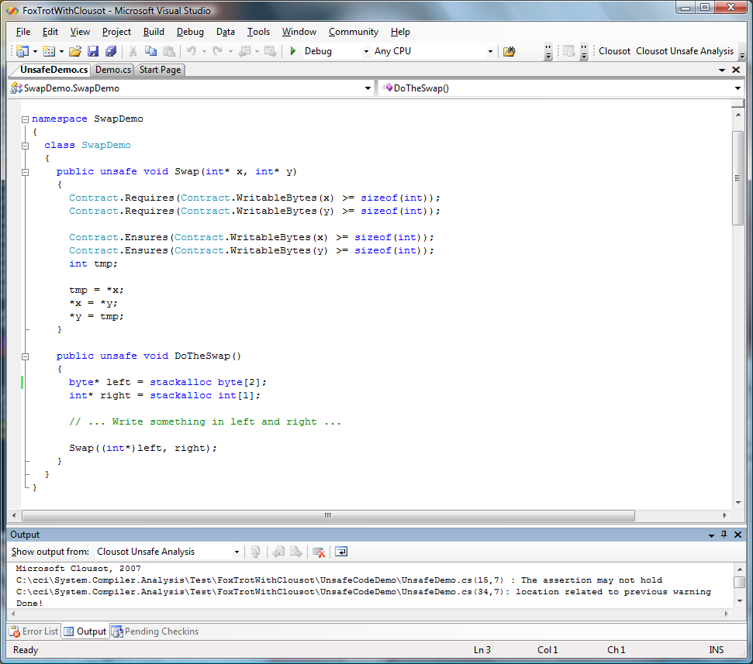
Manuel Fähndrich (maf) Francesco Logozzo (logozzo)
An abstract interpretation-based static analyzer
Language agnostic
MSIL level analysis
IL Reader independent
Pluggable readers architecture
CCI, CCI2, Phoenix, …
Support for contracts
Understand Foxtrot and Spec#
Generic analyzer
Easy to combine and add new abstract domains
Precise & Scalable
Check 83% of mscorlib.dll array accesses in less than 7 minutes
Automatic inference and checking
Array out of bounds
Use new Pentagons domain
a ≤ x ≤ b, x < y
Null dereferences
Memory accesses
Use new Stripes abstract domain
x – a*(y + z) > k
Contract violations
ok: non null
ok: in bounds
ok:“safe” memory accesses
wrong: precondition violated

